Slide 1
A Performance Evaluation of Correlated and Dynamic Topic Modeling on a QA Dataset
Group No - 11
Md. Anonto Shuvo - 23141036
ST - Md Farhadul Islam
RA - Md Sabbir Hossain

Slide 2
Why this Paper?
This paper has discussed and worked on Topic modeling which is similar concept to our project.
There are models used in the paper that will help us to know about its properties, advantages and limitations.
The dataset used in the paper is also a good dataset to work on.

Slide 3
Introduction
Topic modeling is a popular and important technique in natural language processing and information retrieval
It involves discovering latent topics or themes in a collection of documents by analyzing the patterns of words that occur together.
It enables us to uncover hidden structures and patterns in unstructured text data, which can help in a variety of applications
The paper evaluates two topic modeling techniques Correlated Topic Model (CTM) and Dynamic Topic Model (DTM) on a Question Answer dataset based on autism.

Slide 4
Background
Topic modeling is a statistical method used to identify and extract latent topics or themes from a collection of documents
It works by analyzing the co-occurrence patterns of words in a corpus of documents. It seeks to identify the most common sets of words that tend to appear together and to group them into topics based on their co-occurrence patterns.
It can be used for a variety of applications such as document classification, sentiment analysis, content summarization, and trend analysis.
Common topic modeling techniques are Latent Dirichlet Allocation (LDA), Non-Negative Matrix Factorization (NMF), Correlated Topic Model (CTM), Dynamic Topic Model (DTM) and Hierarchical Dirichlet Process (HDP)
Major differences between correlated topic model (CTM) and dynamic topic model (DTM) are seen in Modeling correlations, Handling time, Scalability, Interpretability

Slide 5
Dataset
Question Answer dataset based on autism dataset used in the study
The dataset includes 4000 files related to autism
Dataset was preprocessed for topic modeling - Tokenization, Stop words removal, Stemming, Removal of alphanumeric characters, Term Frequency, Document Frequency, Term-Frequency Inverse Document Frequency and Normalization

Slide 6

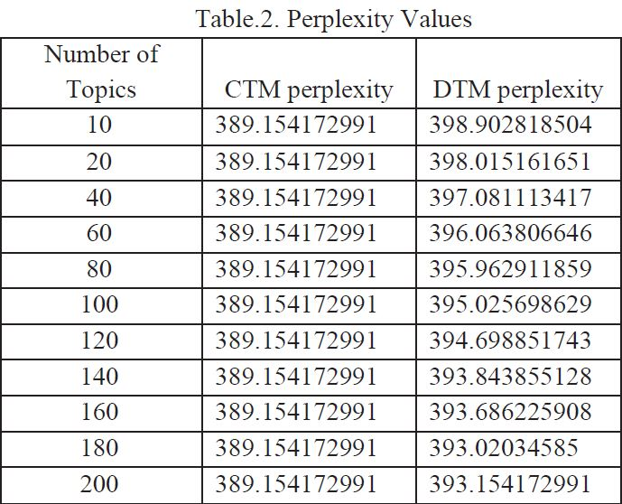
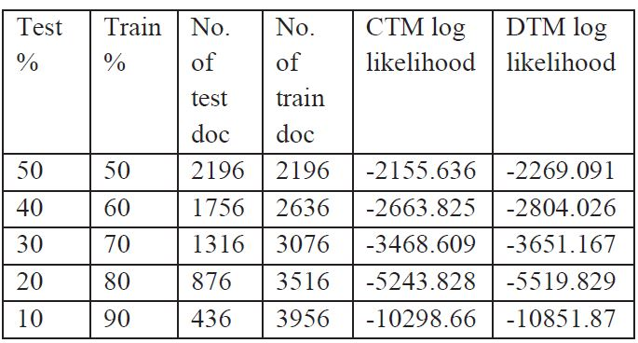
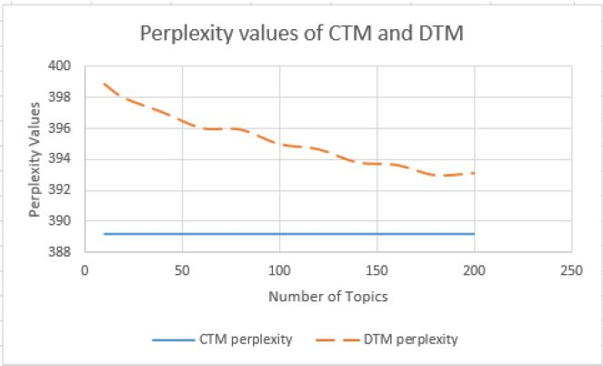
Results
Comparing the plot of perplexity values of two models,
it is analyzed that CTM performs better than DTM as
less value for perplexity causes a model to predict a
sample in a better manner.

Slide 7
Future scope of improvement
Exploring the use of other evaluation metrics in addition to coherence and interpretability, such as topic diversity and topic stability.
Extending the study to include other topic modeling methods beyond CTM and DTM, such as Latent Dirichlet allocation (LDA) and Non-negative Matrix Factorization (NMF)
Applying the topic modeling techniques to other types of text data such as social media posts, news articles, and academic papers.
Integrating the topic modeling techniques with other natural language processing techniques, such as sentiment analysis and named entity recognition, to enable more advanced text analysis and understanding.

Slide 8
Conclusion
The study aimed to investigate the effectiveness of these two topic modeling techniques - Correlated Topic Model (CTM), Dynamic Topic Model (DTM) for extracting meaningful topics from a Question - Answer dataset.
The study's findings can be useful for researchers and practitioners who are interested in applying topic modeling techniques to similar datasets and can help to improve the performance of information retrieval systems in various domains.

